Slide 1
Lecture 8 Turing Machines
Turing machines (TM),
variants of Turing machines and
the Church-Turing thesis

Slide 2
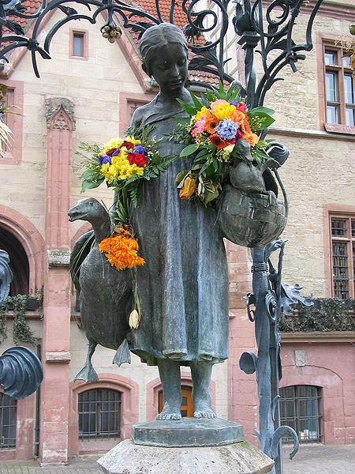
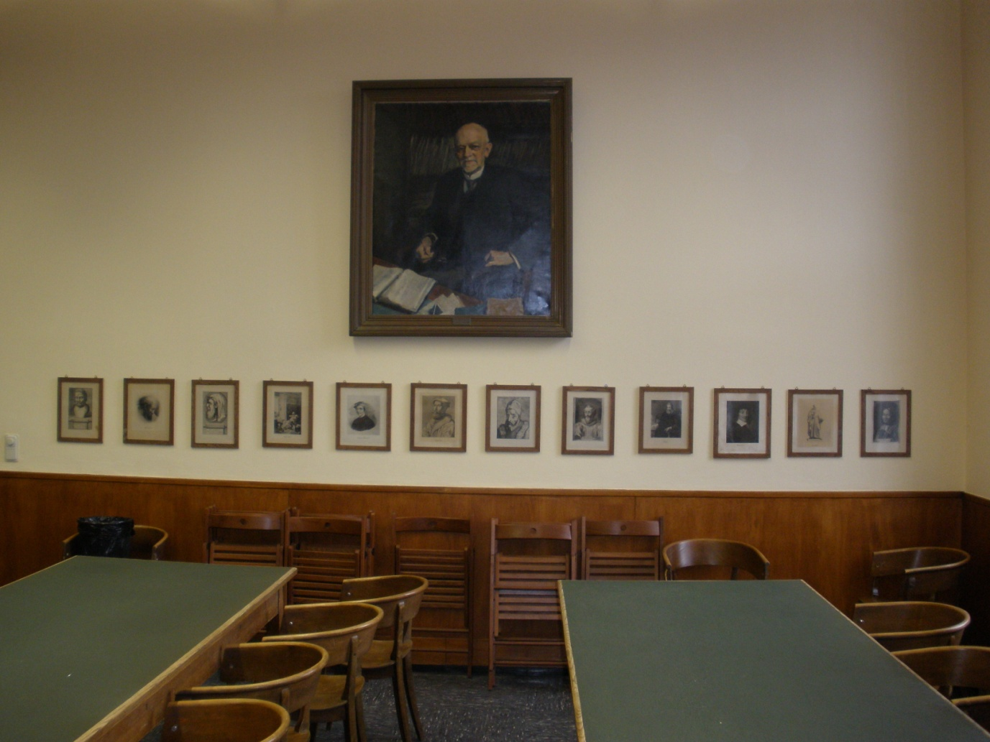
Goettingen and HER Mathematics
Ganseliesel:
the landmark of Goettingen
David Hilbert and
Men of Mathematics

Slide 3
A Brief History: Hilbert’s Program
Hilbert’s program (from wikipedia)
Axiomatization of all mathematics
Completeness: all true mathematical statements can be proved in the formalism
Consistency: no contradiction can be obtained in the formalism of mathematics
Decidability: there should be an algorithm for deciding the truth or falsity of any mathematical statement
“We must know. We will know”.

Slide 4
History: Godel’s Incomplete Theorems
Godel’s first incomplete Theorem
no consistent system of axioms whose theorems can be listed by an "effective procedure" (essentially, a computer program) is capable of proving all facts about the natural numbers.
However, in 1940’s Tarski showed that the first order theory of the real numbers with addition and multiplication is decidable. In this sense, number theory is more difficult than real analysis to computer scientists.

Slide 5
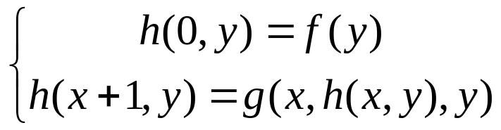

Goedel’s proof
Goedel numbering
Primitive recursive function
Self-reference: Liar Paradox

Slide 6


Goedel and Turing (1931-1936)
(1912-1954)
This year is the Turing year!

Slide 7
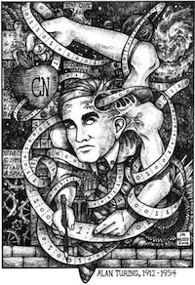
Picture of a Turing Machine (TM)
Action: based on
the state and the
tape symbol under
the head: change
state, rewrite the
symbol and move the
head one square.
State
What are the essential
differences from FA?
A
B
C
A
D
. . .
Infinite tape with
squares containing
tape symbols chosen
from a finite alphabet

Slide 8
Formal definition of TMs
A TM is described by:
  A finite set of states (Q, typically).
  An input alphabet (Σ, typically).
  A tape alphabet (Γ, typically; contains Σ).
  A transition function (δ, typically).
  A start state (q₀, in Q, typically).
  A blank symbol (u, in Γ- Σ, typically).
    All tape except for the input is blank initially.
  A set of final states (F ⊆ Q, typically).

Slide 9
The Transition Function
Takes two arguments:
  A state, in Q.
  A tape symbol in Γ.
δ(q, Z) is a triple of the form (p, Y, D).
  p is a state.
  Y is the new tape symbol.
  D is a direction, L or R.

Slide 10
Actions of the TM
If δ(q, Z) = (p, Y, D) then, in state q, scanning Z under its tape head, the TM:
  Changes the state to p.
  Replaces Z by Y on the tape.
  Moves the head one square in direction D.
    D = L: move left; D = R; move right.

Slide 11
Left-hand end of the tape
If M tries to move its head to the left off the left-hand end of the tape, the head stays in the same place for that move, even though the transition indicates L: (p,1) (q, 0, L)
p
q
1 0
0 0

Slide 12
Example: Turing Machine
This TM scans its input right, looking for a 1.
If it finds one, it changes it to a 0, goes to final state f, and halts.
If it reaches a blank, it changes it to a 1 and moves left.

Slide 13
Example: Turing Machine – (2)
States = {q (start), f (final)}.
Input symbols = {0, 1}.
Tape symbols = {0, 1, B}.
δ(q, 0) = (q, 0, R).
δ(q, 1) = (f, 0, R).
δ(q, B) = (q, 1, L).

Slide 14
Simulation of TM
δ(q, 0) = (q, 0, R)
δ(q, 1) = (f, 0, R)
δ(q, B) = (q, 1, L)
q
0 0 B B . . .

Slide 15
Simulation of TM
δ(q, 0) = (q, 0, R)
δ(q, 1) = (f, 0, R)
δ(q, B) = (q, 1, L)
q
0 0 B B . . .

Slide 16
Simulation of TM
δ(q, 0) = (q, 0, R)
δ(q, 1) = (f, 0, R)
δ(q, B) = (q, 1, L)
q
0 0 B B . . .

Slide 17
Simulation of TM
δ(q, 0) = (q, 0, R)
δ(q, 1) = (f, 0, R)
δ(q, B) = (q, 1, L)
q
0 0 1 B . . .

Slide 18
Simulation of TM
δ(q, 0) = (q, 0, R)
δ(q, 1) = (f, 0, R)
δ(q, B) = (q, 1, L)
q
0 0 1 B . . .

Slide 19
Simulation of TM
δ(q, 0) = (q, 0, R)
δ(q, 1) = (f, 0, R)
δ(q, B) = (q, 1, L)
f
No move is possible.
The TM halts and
accepts.
0 0 0 B . . .

Slide 20
Configuration
Start configuration
Accepting configuration
Rejecting configuration
Halting Configuration
q
00q1B
0 0 1 B . . .

Slide 21
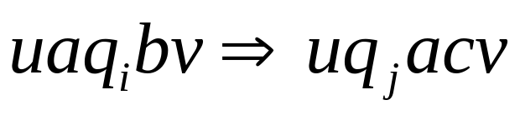
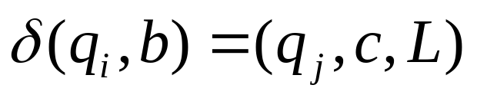
Move
If TM can legally go from one configuration C1 to another configuration C2 in a single step,say,
where
then we call that C1 yields C2

Slide 22
language of TM
A Turing machine M accepts a string w if a sequence of configurations C1, C2, …..,Ck exist such that
C1 is the start configuration of M on w;
Each Ci yields Ci+1 and
Ck is the accepting configuration
L(M)={w|M accepts w}

Slide 23
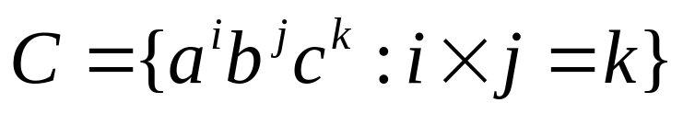
Design Turing machines
Describe a TM M2 that recognizes the language consisting of 0s whose length is a power of 2.
Design a TM that recognizes the language B={w#w|w is string of 0s or 1s}
Design a Turing machine doing some elementary arithmetic. Consider the language

Slide 24
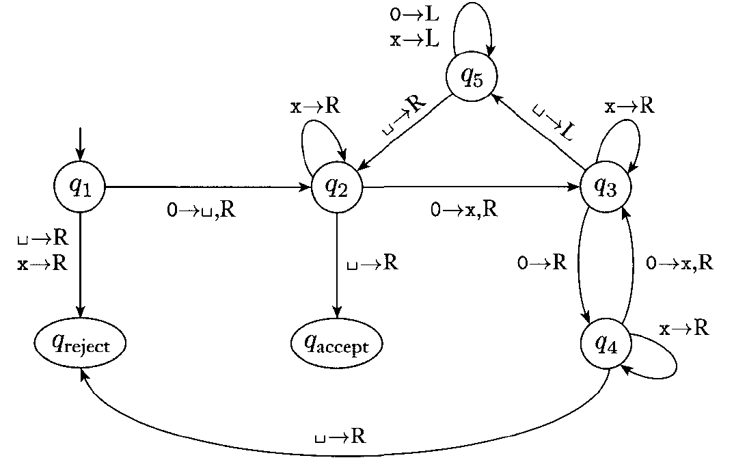

Slide 25
High-level language for M2
M2 = "On input string w:
1. Sweep left to right across the tape,crossing every other 0;
2. If in stage 1 the tape contains a single 0, accept.
3. If in stage 1 the tape contains more than a single 0 abd the number of 0s was odd, reject.
4. Return head to the left-hand end of the tape.
5. Go to stage 1."

Slide 26
Features of TMs
A TM can both read and write on the tape
The read-write head can move both to the right and to the left;
The tape is infinite;
The special states for rejecting and accepting take immediate effect.

Slide 27
PDA: an extension of FA (in what sense)
Finite
State Control
a a a a
input
FA
PDA
X
y
z
X
y
z
X
y
z
Stack: “ last in,first out”
Infinite memory
Example: {0^n1^n: n>=0}

Slide 28
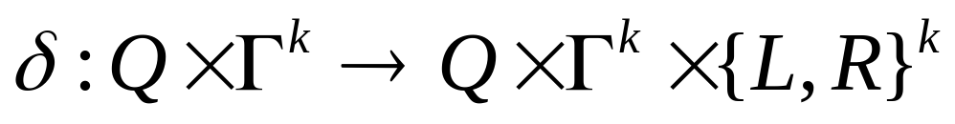
Multitape Turing Machines
Allow a TM to have k tapes for any fixed k.
Move of the TM depends on the state and the symbols under the head for each tape.
In one move, the TM can change state, write symbols under each head, and move each head independently. Initially the input appears on tape 1, and the others start out blank.
Why do the multitape TMs look more powerful
than single-tape TMs?

Slide 29
Simulating multitape TM by single-tape TM
1
0 1 0 1 0 u
M
a
a a a u
b
b a u
S
#
# 0 1 0 1 0 # a a a # b a # u

Slide 30
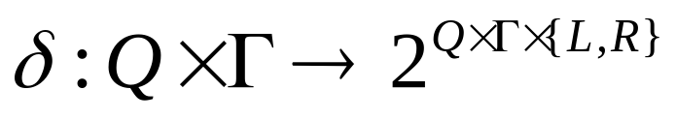
Nondeterministic TM’s
Allow the TM to have a choice of move at each step.
  Each choice is a state-symbol-direction triple, as for the deterministic TM.
The TM accepts its input if any sequence of choices leads to an accepting state.

Slide 31
Computation tree of NTM
nondeterminism
2
Each node is a configuration
1
2
3
1
2
3
1
……..
……..
………
Depth first search? NO

Slide 32
Example: Computation tree
0->1,R
0 -> 0,R
1 ->1,R
q0
1->0,R
q1
0->0,L
1 ->1,L
B->B,R
q2

Slide 33
Simulating NTM with DTM
0
0 0 1 0 u
Input tape
Never altered
D
x
X x # 0 1 x u
Simulation tape
Simulate one branch of computation
1
1 2 3 3 2 3 1 2 1 1 3 u
Address tape
Update according to the lexicographical order

Slide 34
Other models of Computation
Partial computable function (Kleene)
  Computable mathematics
Lambda calculus (Church)
  Programming languages
Register machines
  Computability theory

Slide 35

Church-Turing thesis
Intuitive notion
of algorithm
Turing machine
algorithm
=
f=2x+1 is continuous
=
Prove by definition
An algorithm is a finite collection of instructions for
carrying out some task.

Slide 36
Descriptions of Turing machines
Formal description
Implementation description
  Describe the way that the TM moves its head and the way that it stores data on its tape
High-level description
  Describe an algorithm, and don’t need to mention how the machine manages its tape or head.

